Slide 1
CSE 105 theory of computation
Fall 2020 Week 7

Slide 2
Table of Contents – Quickly Jump to a video’s slides
Monday | Wednesday | Friday
Video 88 | Video 94 | Video 99
Video 89 | Video 95 | Video 100
Video 90 | Video 96 | Video 101
Video 91 | Video 97 | Examples
Video 92 | Video 98 | FAQ
Video 93 | Examples
Examples | FAQ
FAQ

Slide 3
This week’s learning goals
Connect languages and computational problems
Describe and use the encoding of objects as inputs to Turing machines
Describe common computational problems with respect to DFA, NFA, regular expressions, PDA, and context-free grammars.
Give high-level descriptions of Turing machines that decide common computational problems with respect to DFA, NFA, regular expressions, PDA, and context-free grammars.
Give examples of decidable problems.
Trace high-level descriptions of algorithms for computational problems.
Use counting arguments to prove the existence of unrecognizable (undecidable) languages.
Use diagonalization in a proof of undecidability.

Slide 4
Monday
Videos 088-093
Today’s learning goals
Connect languages and computational problems
Describe and use the encoding of objects as inputs to Turing machines
Describe common computational problems with respect to DFA, NFA, regular expressions, PDA, and context-free grammars.
Today’s textbook sections
Section 3.3 pp. 184-185 (Terminology for describing TMs)

Slide 5
088.CSE105.DecidableProblems.mp4
Remember:
Church-Turing Thesis
Anything that is computable is computable with a Turing machine because any method of computation using finite time and finite resources will be equally expressive to that of a Turing machine.

Slide 6
High-level description = Algorithm
Each algorithm can be implemented by some Turing machine.
Church-Turing thesis

Slide 7
Algorithms
So far: machines describing / recognizing sets.
What questions can we answer?
Does a string over {0,1} have even length?
Is a string over {0,1} a C program?
Does a string over {0,1} represent a DFA?
All of the above.
None of the above.

Slide 8
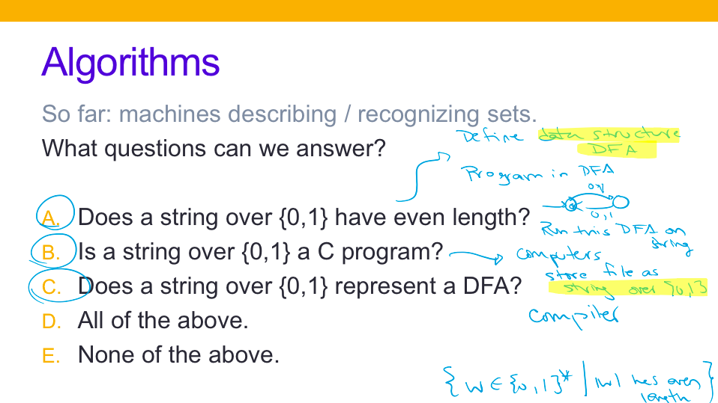

Slide 9
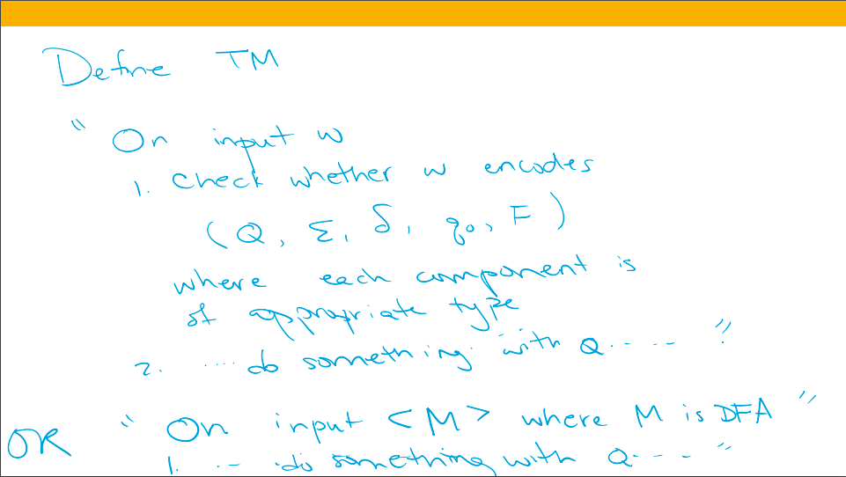

Slide 10
Key Notation and Definitions (088)
To answer the question “Does a string over {0,1} have even length?”, we can construct a DFA, and membership in the language of the DFA corresponds to the answer to the question.

Slide 11
089.CSE105.CodingMachinesAsStrings.mp4
Remember:
Set A well-defined collection of distinct objects
Alphabet Σ A non-empty finite set, usually denoted by Σ
Symbol An element of the alphabet
String over Σ A finite list of symbols from Σ
Language over Σ A set of strings (over Σ)

Slide 12
Representations of algorithms Sipser p. 185
To decide these problems, we need to represent the objects of interest as strings
To define TM M:
"On input w …
..
..
…
For inputs that aren't strings,
we have to encode the object
(represent it as a string) first
Notation:
<O> is the string that represents (encodes) the object O
<O₁, …, O_{n}> is the single string that represents the list of objects O₁, …, O_{n}

Slide 13
Representations of algorithms Sipser p. 185
To decide these problems, we need to represent the objects of interest as strings
To define TM M:
"On input w …
..
..
…
For inputs that aren't strings,
we have to encode the object
(represent it as a string) first
Assumption:
There are Turing machine subroutines that can decode the string representations of common objects so we can interact with them as intended
e.g. from string representation of Turing machine, can decode (Q, Σ, Γ, δ, q₀, q_{acc}, q_{rej})

Slide 14
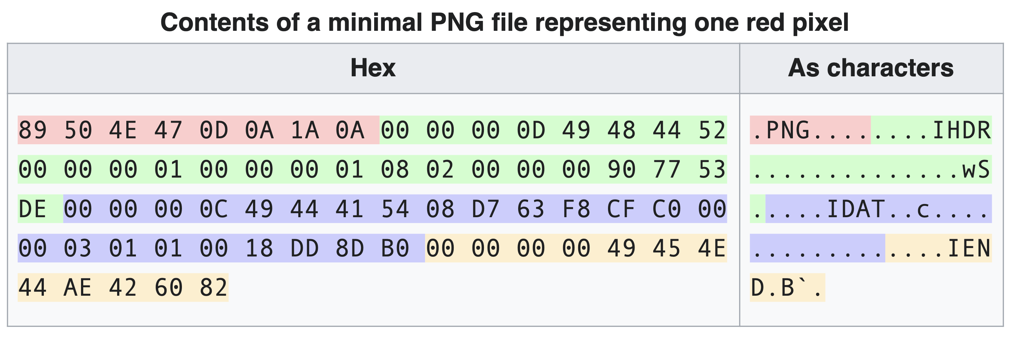

Key Notation and Definitions (089)
<O> is the string that represents (encodes) the object O
<O₁, …, O_{n}> is the single string that represents the list of objects O₁, …, O_{n}
We assume there are Turing machine subroutines that can decode the string representations of common objects so we can interact with them as intended.
decode →

Slide 15
090.CSE105.CodingMachinesAsStringsExample.mp4
Remember:
M is a decider if it is a Turing machine and halts on all inputs.

Slide 16
Representations of algorithms Sipser p. 185
To decide these problems, we need to represent the objects of interest as strings
To define TM M:
"On input w …
..
..
…
For inputs that aren't strings,
we have to encode the object
(represent it as a string) first
Assumption:
There are Turing machine subroutines that can decode the string representations of common objects so we can interact with them as intended
e.g. from string representation of Turing machine, can decode (Q, Σ, Γ, δ, q₀, q_{acc}, q_{rej})

Slide 17
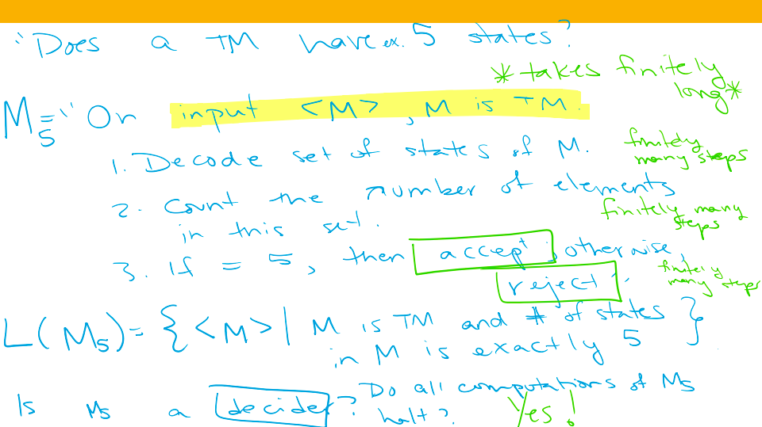

Slide 18
Key Notation and Definitions (090)
In Turing machine M5, input strings that don’t pass the type check are rejected.
Each step of M5 takes finitely many steps, therefore all computations on M5 will halt in finite time.

Slide 19
091.CSE105.ComputationalProblemsAsLanguages.mp4
Remember:
A palindrome is a word, a phrase, or a sequence that reads the same backwards and forwards.

Slide 20
Encoding inputs
Payoff: problems we care about can be reframed as languages of strings
e.g. "Recognize whether a string over Σ is a palindrome."
{ w | w in Σ* and w = w^{R} }
e.g. "Check whether a string is accepted by a DFA."
{ <B,w> | B is a DFA over Σ, w in Σ*, and w is in L(B) }
e.g. "Check whether the language of a PDA is infinite."
{ <A> | A is a PDA and L(A) is infinite}

Slide 21
Encoding inputs
Payoff: problems we care about can be reframed as languages of strings
e.g. "Recognize whether a string over Σ is a palindrome."
{ w | w in Σ* and w = w^{R} }
e.g. "Check whether a string is accepted by a DFA."
{ <B,w> | B is a DFA over Σ, w in Σ*, and w is in L(B) }
e.g. "Check whether the language of a PDA is infinite."
{ <A> | A is a PDA and L(A) is infinite}

Slide 22
Key Notation and Definitions (091)
We can frame problems/questions as sets of strings for which the answer to the problem/question is yes.

Slide 23
092.CSE105.DecidableComputationalProblemsIntro.mp4

Slide 24
Computational problems Sipser p. 194
A computational problem is decidable iff the language encoding the problem instances is decidable
Does a specific DFA accept a given string? encoded by
{ representations of DFAs M and strings w such that w is in L(M) }
Is the language generated by a specific CFG empty? encoded by
{ representations of CFGs G such that L(G) = Ø }
Is a Turing machine a decider? encoded by
{ representations of Turing machines M such that M always halts }

Slide 25
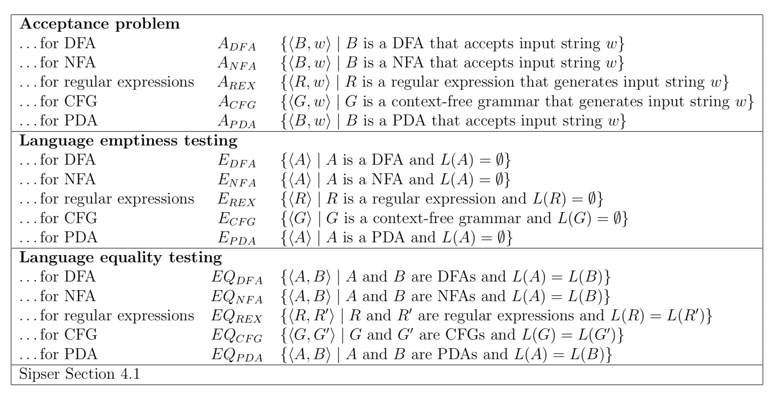
Computational Problems

Slide 26
Key Notation and Definitions (092)
To prove if a computational problem is decidable: need to confirm that the strings in the language are accepted and that the strings not in the language are rejected (no looping allowed).

Slide 27
093.CSE105.ADFAandEDFAandEQDFAExamples.mp4
Remember:
<O> is the string that represents (encodes) the object O

Slide 28
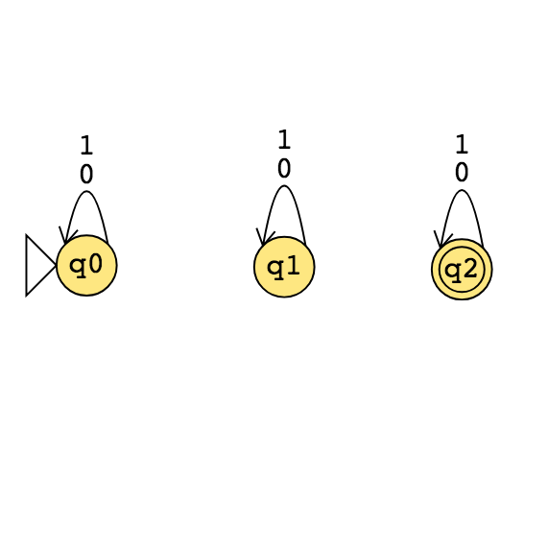
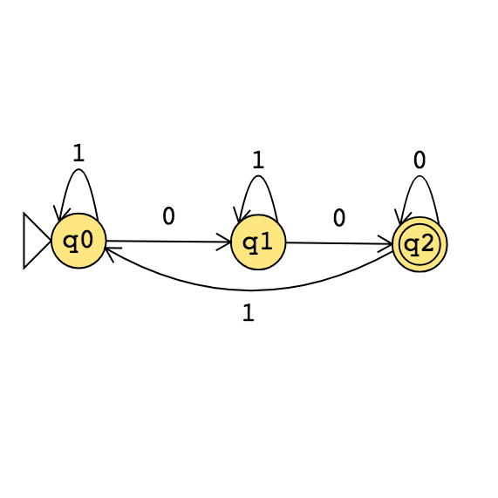
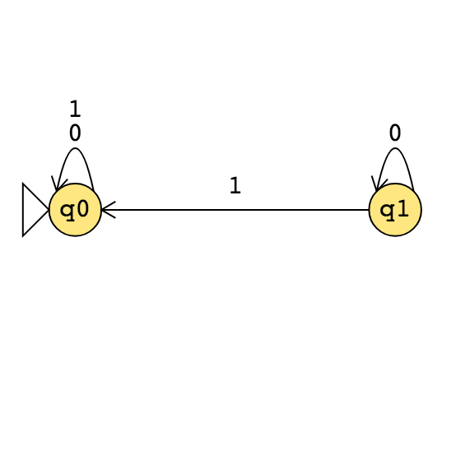
For DFA

Slide 29
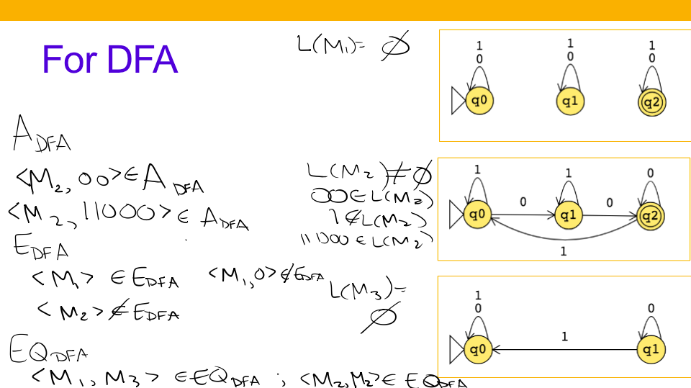

Slide 30
Key Notation and Definitions (093)
E_{DFA} collects strings that represent lists of length 1

Slide 31
Vocabulary/Notation Check
Example 1
Are all decidable languages recognizable?
If A is recognizable and B is decidable, is |A| > |B|
If M is a Turing machine, what is <M>?

Slide 32
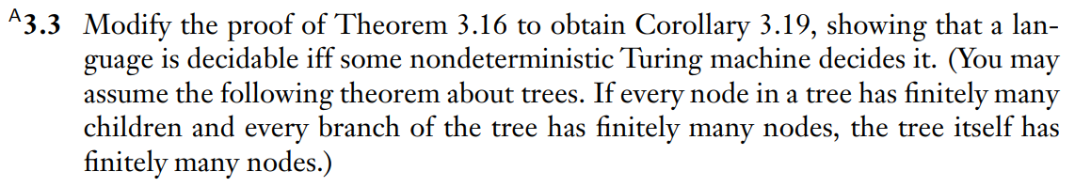
Proving Decidability with Nondeterministic TMs
Example 2
Ch. 3 Exercises pg. 187

Slide 33
Example 1 Solution
No
Not necessarily
A string that encodes the Turing machine, M

Slide 34
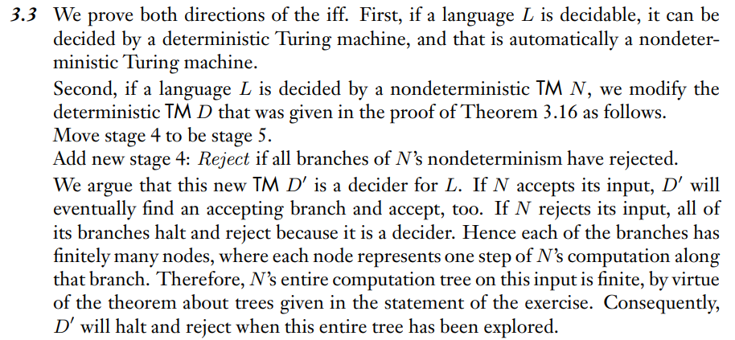
Example 2 Solution
Ch. 3 Solutions pg. 190

Slide 35
Monday FAQ (088-093)
Q: "What does it mean to have the 'encoding' of a machine?"
A: The 'encoding' of a machine is a string that stores all the information we would need to know for us to reconstruct it. In some way, it would need to store all the information that is represented in the formal definition of the machine.
Q: "How exactly do we encode a machine into a string, and how do we recognize a string that is the encoding of a machine?"
A: We do not need to know exactly what the string looks like. We are looking at it from a higher level, similar to how when we write Java code, we don't need to know the individual bits that the computer uses to represent our program. We don't need to 'encode' the machine ourselves or know how it is encoded; we just need to know that there is a string encoding for a machine M that we can represent and recognize using the notation <M>.

Slide 36
Monday FAQ (088-093) cont.
Q: "How do we build a Turing machine that can recognize if a string is an encoding of a Turing machine?"
A: We don't need to 'build' the machine or even know how its implemented, and we are not able to either because we don't know exactly how the string is encoded. However, when we're building a machine that reads strings that are of a certain type of encoding, we can simply include (as a subroutine) the machine that checks if the input string is of the correct type.
Q: "Are A_{DFA}, E_{DFA}, EQ_{DFA}, A_{NFA}, etc. all sets whose elements are machines?"
A: No, these are all sets that contain encodings of machines. For example, E_{DFA} contains the encodings of all the machines whose language is the empty set.

Slide 37
Monday FAQ (088-093) cont.
Q: "In an encoding string, can we include more than just the information about a single machine? For example, can we also include information about other machines or strings?"
A: We can. For example, <M,w> could represent an encoding that contains information about the machine M and also contains the string w. We can use these kinds of strings to specify the different 'parameters' we want to give to our machine, and we can assume that the machine will be able to parse these different values and use them in the computation.

Slide 38
Monday FAQ (088-093) cont.
Q: "Why do we not have to think about the specifics of any of these machines? Why are we only looking at everything from a higher level?"
A: We learned about exactly how these machines worked under-the-hood so that we could understand them fully. Now that we know how they work, we don't need to go about implementing them or thinking about the lower-level specifics every time, especially as we get to more complicated algorithms. Rather, we can take a step back and focus on using them in more powerful computations.

Slide 39
Wednesday
Videos 094-098
Today’s learning goals
Give high-level descriptions of Turing machines that decide common computational problems with respect to DFA, NFA, regular expressions, PDA, and context-free grammars.
Give examples of decidable problems.
Today’s textbook sections
Intro to section 4.1 "Decidable problems concerning regular languages" p.194

Slide 40
094.CSE105.ADFADecidable.mp4
Remember:
In a high-level description of a Turing machine, a Turing machine can simulate (run) other Turing machines / algorithms as subroutines of program being defined.

Slide 41
Computational problems
A computational problem is decidable iff the language encoding the problem instances is decidable.
We won't specify the encoding.
To prove decidable, define TM M = "On input <_______>,
1.
2. "
Show (1) L(M) = … and (2) M is a decider.

Slide 42
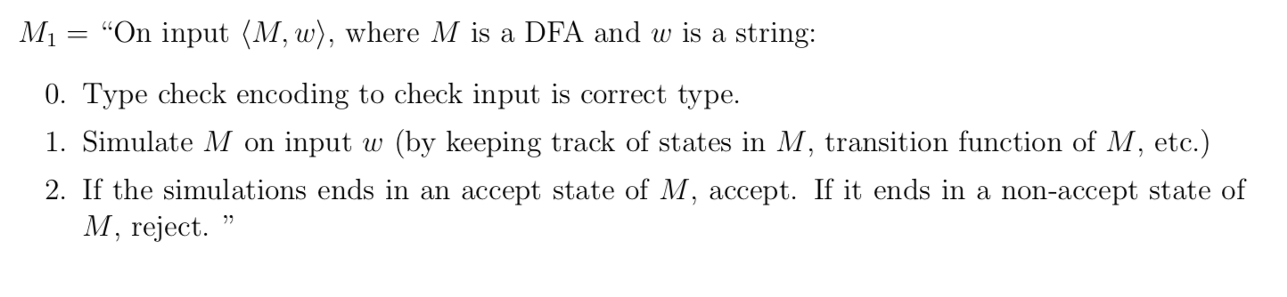
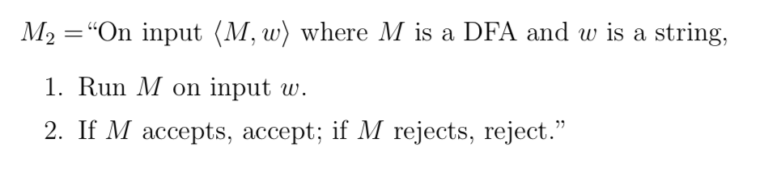
A_{DFA}

Slide 43
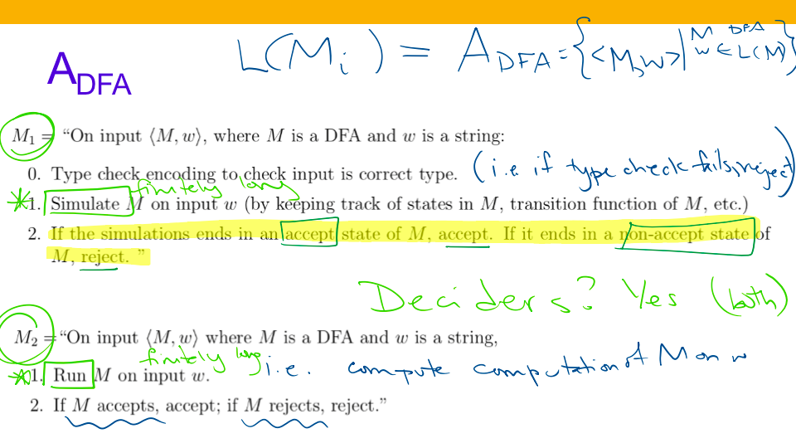

Slide 44
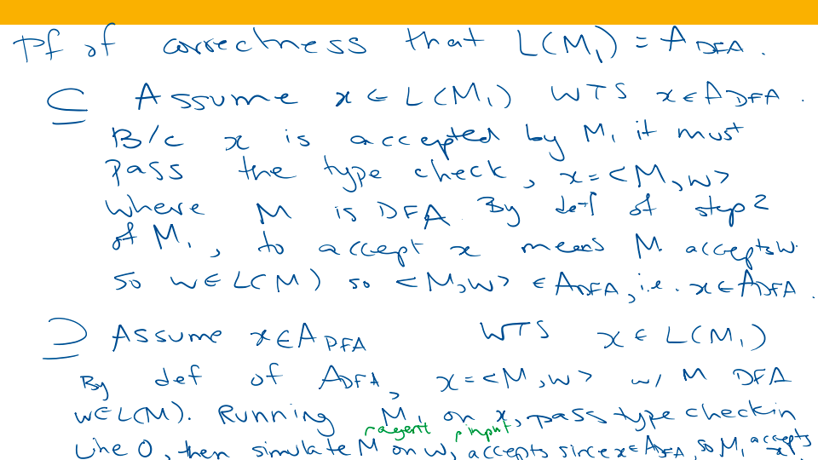

Slide 45
Key Notation and Definitions (094)
The language of a TM is the set of strings that are accepted by the TM.
When doing a proof of correctness, we’re trying to prove a set equality, therefore we need to prove subset inclusion in two directions.

Slide 46
095.CSE105.AREXandANFADecidable.mp4
Remember:
DFA and NFA are equally expressive. You can always construct a DFA to recognize the same language that an NFA does.

Slide 47
Computational problems
Compare:
A_{REX} = A_{NFA} = A_{DFA}
They're all decidable, some are equal and some not.
They're of different types so all are different.
None of the above

Slide 48
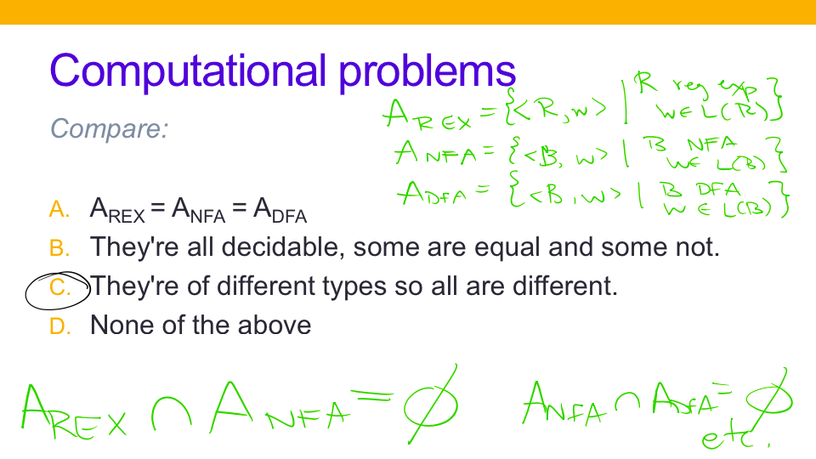

Slide 50
A_{NFA}

Slide 51
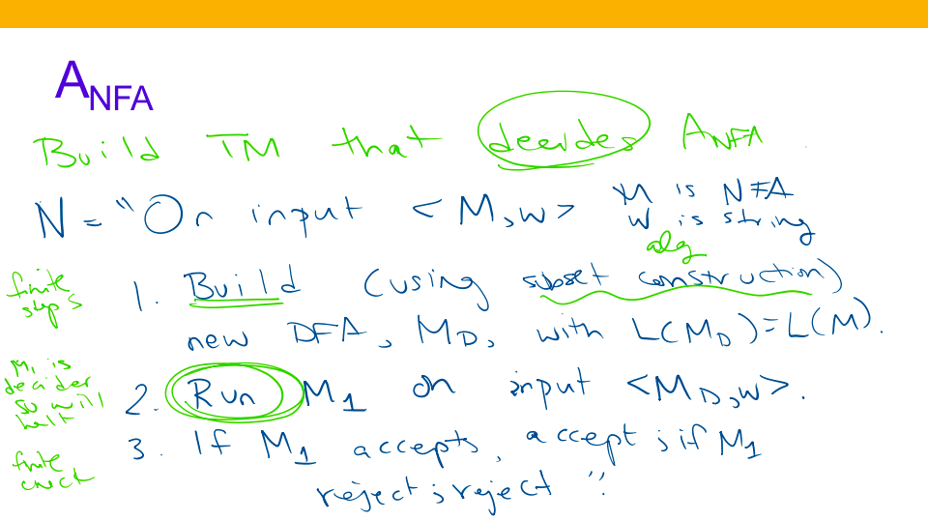
M₁ is defined in the previous video

Slide 52
A_{REX}

Slide 53
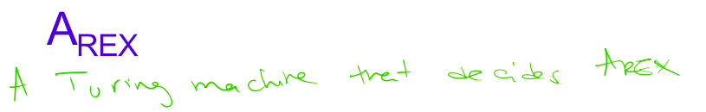
A_{REX}
Left as an exercise

Slide 54
Key Notation and Definitions (095)
DFA and NFA’s transition functions have different signatures.
In high level description of TM, the Build subroutine (such as building a DFA from NFA) often takes finite steps.

Slide 55
096.CSE105.EDFADecidable.mp4
Remember:

Slide 56
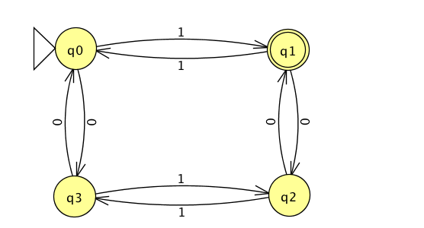
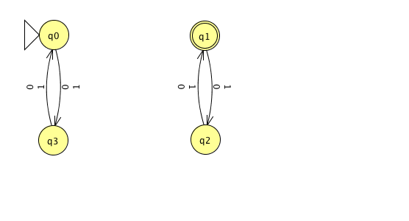
Proving decidability
Claim: E_{DFA} is decidable
Proof: WTS that { <A> | A is a DFA over Σ, L(A) is empty } is decidable.
A
B

Slide 57






Proving decidability
Claim: E_{DFA} is decidable
Proof: WTS that { <A> | A is a DFA over Σ, L(A) is empty } is decidable.
A
B

Slide 58

Proving decidability
Claim: E_{DFA} is decidable
Proof: WTS that { <A> | A is a DFA over Σ, L(A) is empty } is decidable.
e.g.< > is in E_{DFA} ; < > is not in E_{DFA}
TM deciding E_{DFA} should accept and should reject

Slide 59



Proving decidability
Claim: E_{DFA} is decidable
Proof: WTS that { <A> | A is a DFA over Σ, L(A) is empty } is decidable. Idea: give high-level description
Step 1: construction
What condition distinguishes between DFA that accept *some* string and those that don't accept *any*?

Slide 60
Proving decidability
Claim: E_{DFA} is decidable
Proof: WTS that { <A> | A is a DFA over Σ, L(A) is empty } is decidable. Idea: give high-level description
Step 1: construction
What condition distinguishes between DFA that accept *some* string and those that don't accept *any*?
Breadth first search in transition diagram to look for path from start state to an accepting state

Slide 61
Proving decidability
Claim: E_{DFA} is decidable
Proof: WTS that { <A> | A is a DFA over Σ, L(A) is empty } is decidable. Idea: give high-level description
Step 1: construction
Define TM M₂ by: M₂ = "On input <A>:
Check whether input is a valid encoding of a DFA; if not, reject.
Mark the start state of A.
Repeat until no new states get marked:
Loop over states of A and mark any unmarked state that has an incoming edge from a marked state.
If no final state of A is marked, accept; otherwise, reject.

Slide 62


Proving decidability
Claim: E_{DFA} is decidable
Proof: WTS that { <A> | A is a DFA over Σ, L(A) is empty } is decidable. Idea: give high-level description
Step 1: construction
Define TM M₂ by: M₂ = "On input <A>:
Check whether input is a valid encoding of a DFA; if not, reject.
Mark the start state of A.
Repeat until no new states get marked:
Loop over states of A and mark any unmarked state that has an incoming edge from a marked state.
If no final state of A is marked, accept; otherwise, reject.
If a final state is reachable from the start state, it means that some string will be accepted. So the language of the DFA is not empty, and its encoding will not be in E_{DFA}.

Slide 63
M2 on x accepts iff x ∈ E_{DFA}
M₂ on <A,01> | Reject (type)
M₂ on <A> | Reject (b/c there's marked state)
M₂ on <B,01> | Reject (type)
M₂ on <B> | Accept

Slide 64
Proving decidability
Step 1: construction
Define TM M₂ by: M₂ = "On input <A>:
Check whether input is a valid encoding of a DFA; if not, reject.
Mark the state state of A.
Repeat until no new states get marked:
Loop over states of A and mark any unmarked state that has an incoming edge from a marked state.
If no final state of A is marked, accept; otherwise, reject.
Step 2: correctness proof
WTS (1) L(M₂) = E_{DFA} and (2) M₂ is a decider.

Slide 65
Proving decidability
Goal #1 Consider x = <A> w/
L(A) = ∅. Trace M2 on x.
Use steps of M2 to
show M2 accepts x.
Goal #2 Consider x
x [not equal] <A>
x = <A>, L(A) ≠ ∅ … M2
rejects x
Step 1: construction
Define TM M₂ by: M₂ = "On input <A>:
Check whether input is a valid encoding of a DFA; if not, reject.
Mark the state state of A.
Repeat until no new states get marked:
Loop over states of A and mark any unmarked state that has an incoming edge from a marked state.
If no final state of A is marked, accept; otherwise, reject.
Step 2: correctness proof
WTS (1) L(M₂) = E_{DFA} and (2) M₂ is a decider.

Slide 66
Key Notation and Definitions (096)
E_{DFA} is the set of strings, and the strings in this set are all the strings that are codes for DFAs whose languages are empty.
“On input <A>” implies that we’ve already done the type check for A.
If the problem is decided by some TM, then we need to show that when a string isn’t in the language, the TM rejects.
Showing that the TM does not accept the string (maybe loops forever) is not enough to prove decidability.

Slide 67
097.CSE105.EQDFADecidable.mp4
Remember:
The language of a DFA could be countably infinite.

Slide 68

Proving decidability
Claim: EQ_{DFA} is decidable
Proof: WTS that { <A, B> | A, B are DFA over Σ, L(A) = L(B) } is decidable. Idea: give high-level description
Step 1: construction
Will we be able to simulate A and B?
What does set equality mean?
Can we use our previous work?

Slide 69
Proving decidability
Claim: EQ_{DFA} is decidable
Proof: WTS that { <A, B> | A, B are DFA over Σ, L(A) = L(B) } is decidable. Idea: give high-level description
Step 1: construction
Will we be able to simulate A and B?
What does set equality mean?
Can we use our previous work?

Slide 70







Proving decidability
Claim: EQ_{DFA} is decidable
Proof: WTS that { <A, B> | A, B are DFA over Σ, L(A) = L(B) } is decidable. Idea: give high-level description
Step 1: construction
Will we be able to simulate A and B?
What does set equality mean?
Can we use our previous work?

Slide 71
Proving decidability
Claim: EQ_{DFA} is decidable
Proof: WTS that { <A, B> | A, B are DFA over Σ, L(A) = L(B) } is decidable. Idea: give high-level description
Step 1: construction
Very high-level:
Build new DFA recognizing symmetric difference of L(A), L(B). Check if this set is empty.

Slide 72

Proving decidability
Claim: EQ_{DFA} is decidable
Proof: WTS that { <A, B> | A, B are DFA over Σ, L(A) = L(B) } is decidable. Idea: give high-level description
Step 1: construction
Define TM M₃ by: M₃ = "On input <A,B>:
Check whether input is valid encoding of pair of DFAs; if not, reject.
Construct a new DFA, D, from A,B using algorithms for complementing, taking unions of regular languages such that L(D) = symmetric difference of L(A) and L(B).
Run machine M₂ on <D>.
If it accepts, accept; if it rejects, reject."

Slide 73
Proving decidability
Step 1: construction
Define TM M₃ by: M₃ = "On input <A,B>:
Check whether input is valid encoding of pair of DFAs; if not, reject.
Construct a new DFA, D, from A,B using algorithms for complementing, taking unions of regular languages such that L(D) = symmetric difference of L(A) and L(B).
Run machine M₂ on <D>.
If it accepts, accept; if it rejects, reject."
Step 2: correctness proof
WTS (1) L(M₃) = EQ_{DFA} and (2) M₃ is a decider.

Slide 74
Key Notation and Definitions (097)
EQ_{DFA} compares code of two DFAs and check if the language of one equals the language of the other.
Old constructions (e.g. union, concatenation of DFA) that we’ve proven can now be used in high-level description of Turing machines.

Slide 75
098.CSE105.DecidabilityProofsRecap.mp4

Slide 76
Techniques Sipser 4.1
Subroutines: can use decision procedures of decidable problems as subroutines in other algorithms
A_{DFA}
E_{DFA}
EQ_{DFA}
Constructions: can use algorithms for constructions as subroutines in other algorithms
Converting DFA to DFA recognizing complement (or Kleene star).
Converting two DFA/NFA to one recognizing union (or intersection, concatenation).
Converting NFA to equivalent DFA.
Converting regular expression to equivalent NFA.
Converting DFA to equivalent regular expression.

Slide 77
Undecidable?
There are many ways to prove that a problem is decidable.
How do we find (and prove) that a problem is not decidable?

Slide 78
Key Notation and Definitions (098)
Constructions (e.g. converting NFA to equivalent DFA) can be used as subroutines insides a TM

Slide 79
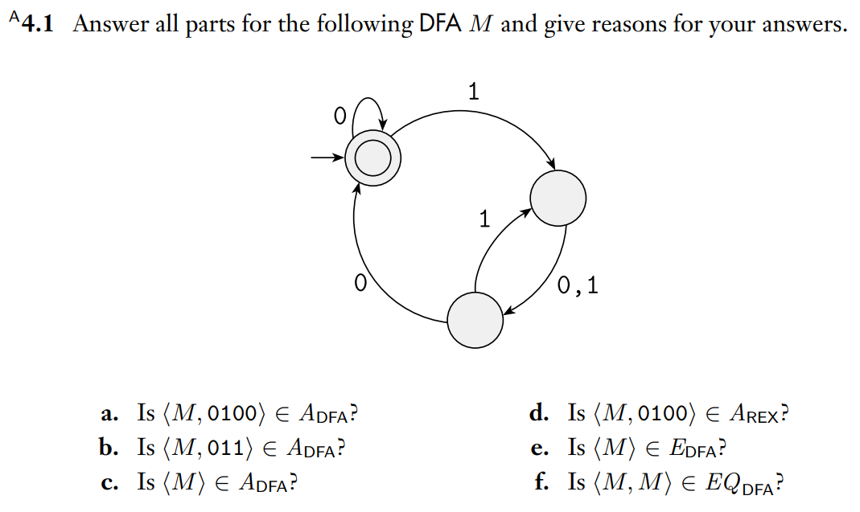

Membership in $?_{DFA}$
Example 1
Ch. 4 Exercises pg. 210

Slide 80

Proving ${INFINITE}_{DFA}$ Decidability
Example 2
Ch. 4 Problems pg. 211

Slide 81
Another Decidability Proof
Example 3
Ch. 4 Problems pg. 211

Slide 82
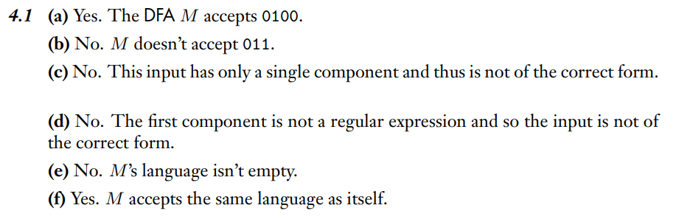
Example 1 Solution
Ch. 4 Solutions pg. 213

Slide 83
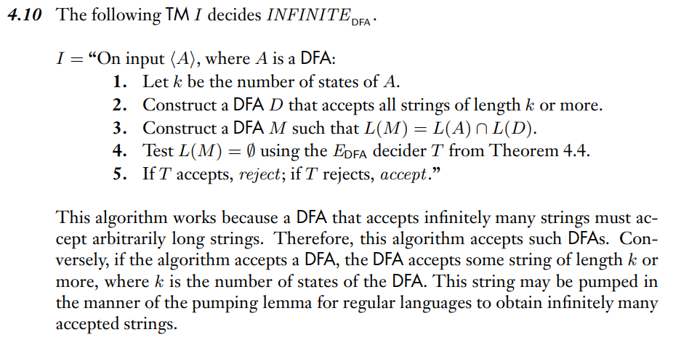
Example 2 Solution
Ch. 4 Solutions pg. 213

Slide 84
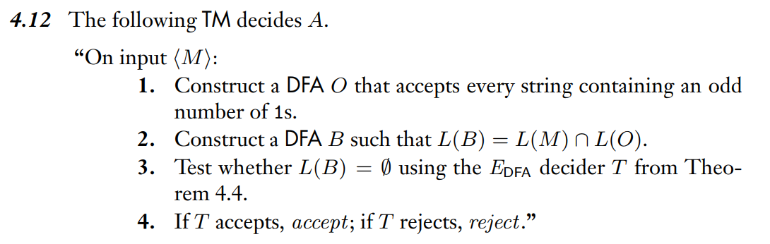
Example 3 Solution
Ch. 4 Solutions pg. 214

Slide 85
Wednesday FAQ (094-098)
Q: "Do all subroutines in a machine have to be deciders for the machine to be a decider?"
A: Yes, for a machine to be a decider, it must reach an accept or reject state for every possible input. If there is any possibility that the computation will enter an infinite loop in any of the subroutines, then the machine is not a decider.
Q: "What is the point in checking if a machine is a decider?"
A: Deciders are more practical: if we are actually implementing a Turing machine, we don't want it to loop since that will cause our algorithm to hang.

Slide 86
Wednesday FAQ (094-098) cont.
Q: "When trying to prove the decidability of a machine M1 using another machine, how do we know how to split in M1 into subroutines that can help us do that? Is there something specific we're supposed to be looking for?"
A: This is what algorithm design (CSE 101 and beyond) is all about! How do we reduce new problems to ones we already know how to solve? Sometimes we need to be creative and invent a new approach, sometimes we can modify an example we've already seen.

Slide 87
Friday
Videos 099-101
Today’s learning goals
Trace high-level descriptions of algorithms for computational problems.
Use counting arguments to prove the existence of unrecognizable (undecidable) languages.
Use diagonalization in a proof of undecidability.
Today’s textbook sections
Intro to section 4.2 pp. 201-202

Slide 88
099.CSE105.UndecidabilityCountingArgument.mp4
Remember:
There are countably infinite many regular languages.
The power set of a countably infinite set is uncountably infinite.

Slide 89
Computational problems
A computational problem is decidable iff the language encoding the problem instances is decidable.
In Siper 4.1: The computational problems below
A_{DFA}, A_{NFA}, A_{REX}, A_{CFG}
E_{DFA}, E_{NFA}, E_{REX}, E_{CFG}
EQ_{DFA}, EQ_{NFA}, EQ_{REX}
are all decidable

Slide 90
Computational problems
A computational problem is decidable iff the language encoding the problem instances is decidable.
In Siper 4.1: The computational problems below
A_{DFA}, A_{NFA}, A_{REX}, A_{CFG}
E_{DFA}, E_{NFA}, E_{REX}, E_{CFG}
EQ_{DFA}, EQ_{NFA}, EQ_{REX}
are all decidable

Slide 91
Undecidable?
There are many ways to prove that a problem is decidable.
How do we find (and prove) that a problem is not decidable?

Slide 92










Undecidable?
There are many ways to prove that a problem is decidable.
How do we find (and prove) that a problem is not decidable?

Slide 93
Counting arguments
Before we proved the Pumping Lemma …
We proved there was a set that was not regular because
Uncountable
All sets of strings
All Regular
Sets
Countable

Slide 94


Counting arguments
Before we proved the Pumping Lemma …
We proved there was a set that was not regular because
Uncountable
All sets of strings
All Regular
Sets
Countable

Slide 95
Reminder: countable/ uncountable
Sets A and B have the same size |A| = |B| means there is a function between them that is both one-to-one and onto.
Sipser p. 202-204
Countable (finite or same size as N) | Uncountable
N, Z, Q | R
Σ* | { infinite sequences over Σ}
The set of all TMs | P( Σ*)

Slide 96
Counting arguments
Uncountable
All sets of strings
All Turing-recognizable sets
Countable
Why is the set of Turing-recognizable languages countable?
It's equal to the set of all TMs, which we showed is countable.
It's a subset of the set of all TMs, which we showed is countable.
Each Turing-recognizable language is associated with a TM, so there can be no more Turing-recognizable languages than TMs.
More than one of the above.
I don't know.

Slide 97







Counting arguments
Uncountable
All sets of strings
All Turing-recognizable sets
Countable
Why is the set of Turing-recognizable languages countable?
It's equal to the set of all TMs, which we showed is countable.
It's a subset of the set of all TMs, which we showed is countable.
Each Turing-recognizable language is associated with a TM, so there can be no more Turing-recognizable languages than TMs.
More than one of the above.
I don't know.

Slide 98
Counting arguments
Uncountable
All sets of strings
Is the set of Turing-decidable sets countable?
All Turing-recognizable sets
Countable

Slide 99











Counting arguments
Uncountable
All sets of strings
Is the set of Turing-decidable sets countable?
All Turing-recognizable sets
Countable

Slide 100
Key Notation and Definitions (099)
A problem being not decidable means that no algorithm can decide the problem.
The set of Turing-recognizable languages is languages described by TMs. It’s not the collection of actual Turing machines.
The set of Turing-decidable languages is a subset of the set of Turing-recognizable languages.

Slide 101
100.CSE105.ATMRecognizable.mp4

Slide 102
Satisfied?
Maybe not...
What's a specific example of a language that is not Turing-recognizable? or not Turing-decidable?
Cantor’s diagonalization.
Idea: consider a set that, were it to be Turing-decidable, would have to "talk" about itself, and contradict itself!

Slide 103
A_{TM}
Recall A_{DFA} = {<B,w> | B is a DFA and w is in L(B) }
A_{TM} = {<M,w> | M is a TM and w is in L(M) }
What is A_{TM} ?
A Turing machine whose input is codes of TMs and strings.
A set of pairs of TMs and strings.
A set of strings that encode TMs and strings.
Not well defined.
I don't know.

Slide 104




A_{TM}
Recall A_{DFA} = {<B,w> | B is a DFA and w is in L(B) }
A_{TM} = {<M,w> | M is a TM and w is in L(M) }
What is A_{TM} ?
A Turing machine whose input is codes of TMs and strings.
A set of pairs of TMs and strings.
A set of strings that encode TMs and strings.
Not well defined.
I don't know.

Slide 105
A_{TM}
A_{TM} = {<M,w> | M is a TM and w is in L(M) }
Define the TM N = "On input <M,w>:
Simulate M on w.
If M accepts, accept. If M rejects, reject."
Which of the following statements is true?
A. N decides A_{TM} B. N recognizes A_{TM}
C. N always halts D. More than one of the above.
E. I don't know

Slide 106






A_{TM}
A_{TM} = {<M,w> | M is a TM and w is in L(M) }
Define the TM N = "On input <M,w>:
Simulate M on w.
If M accepts, accept. If M rejects, reject."
Which of the following statements is true?
A. N decides A_{TM} B. N recognizes A_{TM}
C. N always halts D. More than one of the above.
E. I don't know

Slide 107
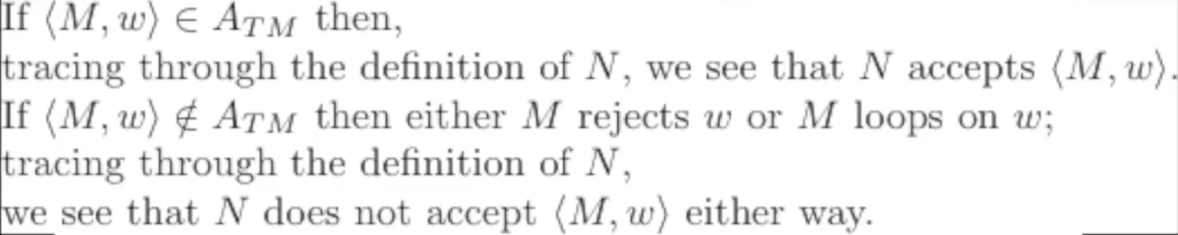
Key Notation and Definitions (100)
“w is not in L(M)” means that M rejects w or M loops on w.
Define the TM N = "On input <M,w>:
Simulate M on w.
If M accepts, accept. If M rejects, reject."

Slide 108
101.CSE105.ATMUndecidableDiagonalization.mp4
Remember:

Slide 109
A_{TM}
A_{DFA} = {<B,w> | B is a DFA and w is in L(B) }
Decider for this set simulates arbitrary DFA
A_{TM} = {<M,w> | M is a TM and w is in L(M) }
Decider for this set simulates arbitrary TMs.
What happens when it simulates itself?
WTS uh oh

Slide 110
Diagonalization proof: A_{TM} not decidable Sipser p. 207
Assume, towards a contradiction, that it is.
Call M_{ATM} the decider for A_{TM}:
For every TM M and every string w,
Computation of M_{ATM} on <M,w> halts and accepts if w is in L(M).
Computation of M_{ATM} on <M,w> halts and rejects if w is not in L(M).
M_{ATM} ≠ N

Slide 111

Diagonalization proof: A_{TM} not decidable Sipser p. 207
Assume, towards a contradiction, that it is.
Call M_{ATM} the decider for A_{TM}:
For every TM M and every string w,
Computation of M_{ATM} on <M,w> halts and accepts if w is in L(M).
Computation of M_{ATM} on <M,w> halts and rejects if w is not in L(M).
M_{ATM} ≠ N

Slide 112
Diagonalization proof: A_{TM} not decidable Sipser 4.11
Assume, towards a contradiction, that M_{ATM} decides A_{TM}
Define the TM D = "On input <M>:
Run M_{ATM} on <M, <M>>.
If M_{ATM} accepts, reject; if M_{ATM} rejects, accept."

Slide 113


Diagonalization proof: A_{TM} not decidable Sipser 4.11
Assume, towards a contradiction, that M_{ATM} decides A_{TM}
Define the TM D = "On input <M>:
Run M_{ATM} on <M, <M>>.
If M_{ATM} accepts, reject; if M_{ATM} rejects, accept."

Slide 114
Diagonalization proof: A_{TM} not decidable Sipser 4.11
Assume, towards a contradiction, that M_{ATM} decides A_{TM}
Define the TM D = "On input <M>:
Run M_{ATM} on <M, <M>>.
If M_{ATM} accepts, reject; if M_{ATM} rejects, accept."
Consider running D on input <D>. Because D is a decider:
either computation halts and accepts …
or computation halts and rejects …

Slide 115


Diagonalization proof: A_{TM} not decidable Sipser 4.11
Assume, towards a contradiction, that M_{ATM} decides A_{TM}
Define the TM D = "On input <M>:
Run M_{ATM} on <M, <M>>.
If M_{ATM} accepts, reject; if M_{ATM} rejects, accept."
Consider running D on input <D>. Because D is a decider:
either computation halts and accepts …
or computation halts and rejects …

Slide 116
A_{TM}
Recognizable
Not decidable

Slide 117
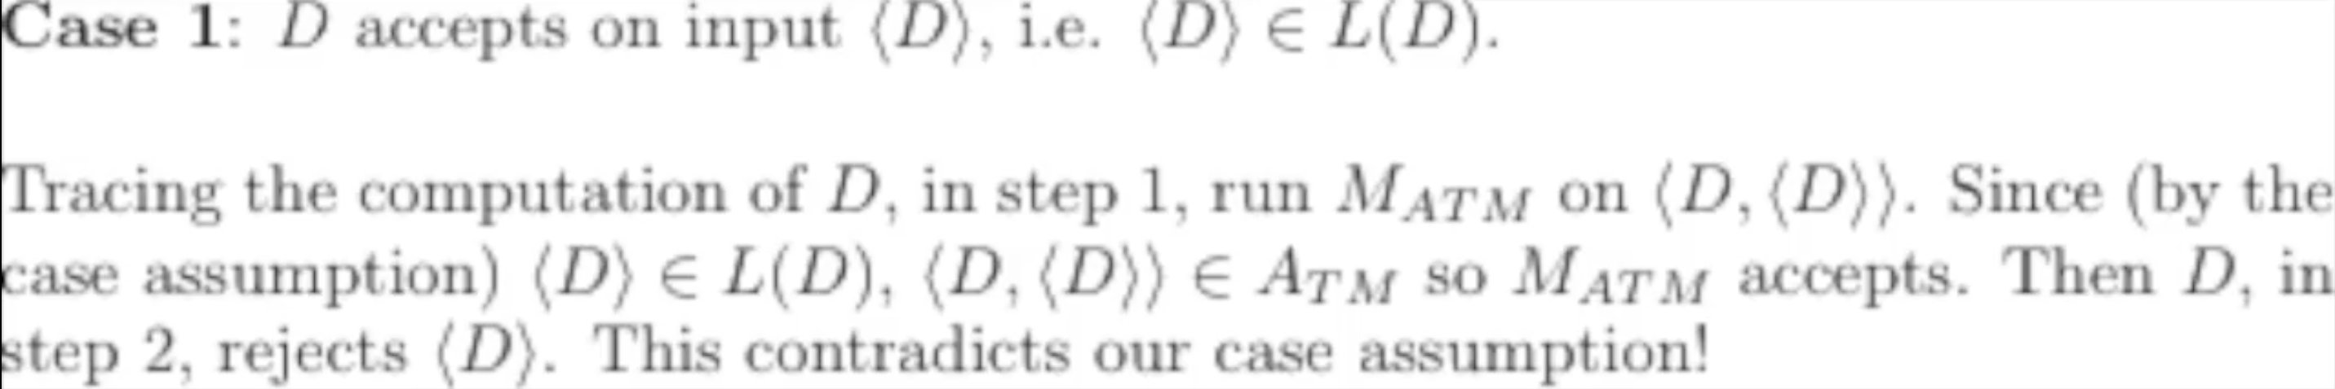
Key Notation and Definitions (101)
Running M_{ATM} on <M, <M>> means feeding the machine M its own code as input.
A_{TM} is recognizable and NOT decidable

Slide 118
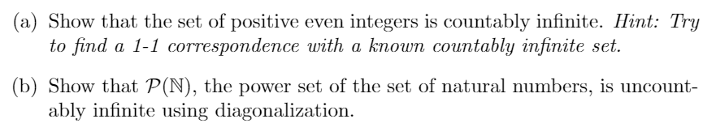
Countability and Diagonalization
Example 1

Slide 119
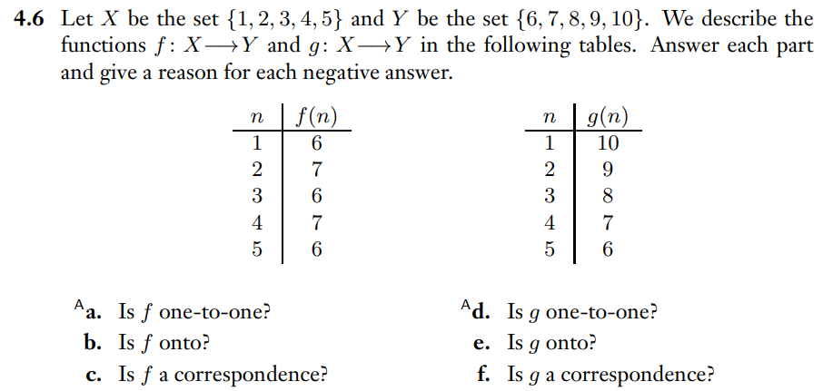
Terminology Check
Example 2
Ch. 4 Exercises pg. 211

Slide 120
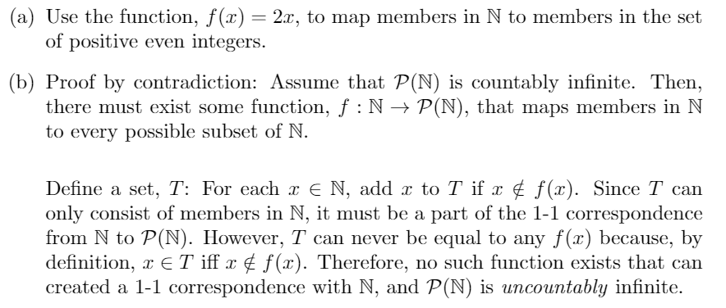
Example 1 Solution

Slide 121
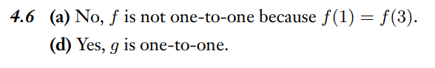
Example 2 Solution
Ch. 4 Solutions pg. 213

Slide 122
Friday FAQ (099-101)
Q: "How is it possible that we can take a machine and run the encoding of itself on it?"
A: The encoding of the machine will be a string, so we would just feed that string as an input to the machine as we normally would.
Q: "In the diagonalization proof, it seems like we are just creating machines that run machines that run other machines that we create. Is that really necessary, or can we cut down on the number of machines we have to create, so that it's less confusing?"
A: The self-reference is at the heart of diagonalization. The reason we can prove that A_{TM} is undecidable is that if it were decidable, it would be able to "work against" itself.

Slide 123
Friday FAQ (099-101) cont.
Q: "This all seems very very complicated. How did someone come up with all of it in the first place?"
A: Alan Turing developed this concept in the 1930s. You can read his original paper here .
Q: "What is the point in figuring out if a machine whose language is a set of encodings of decidable machines is also a decider?"
A: This tells us the difference between questions about TMs that are recognizable and those that decidable. Some properties of languages of TMs we can find enough evidence for in finite time but we can't disprove in finite time.

